Slide 1
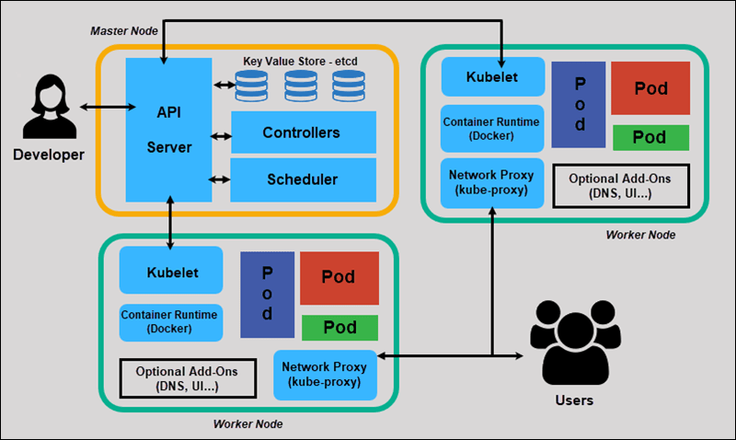
Kubernetes Architecture:

Slide 2
API Server:
The API (application programming interface) server determines if a request is valid and then processes it. The API used to manage, create, and configure Kubernetes clusters. It's how the users, external components, and parts of your cluster all communicate with each other.
Controllers:
In Kubernetes, controllers are control loops that watch the state of your cluster, then make or request changes where needed. Each controller tries to move the current cluster state closer to the desired state.

Slide 3
Scheduler:
In Kubernetes, scheduling refers to making sure that Pods are matched to Nodes so that Kubelet can run them.
Kublet:
The kubelet is the primary "node agent" that runs on each node. It can register the node with the api server using one of the hostname; a flag to override the hostname; or specific logic for a cloud provider.
Pod:
Pods are the smallest, most basic deployable objects in Kubernetes. A Pod represents a single instance of a running process in your cluster. Pods contain one or more containers, such as Docker containers.

Slide 4
ETCD:
It will store key-value pairs and master and worker data
KubeProxy:
It is responsible for internal communication.

Slide 5
Thank You

